Slide 1
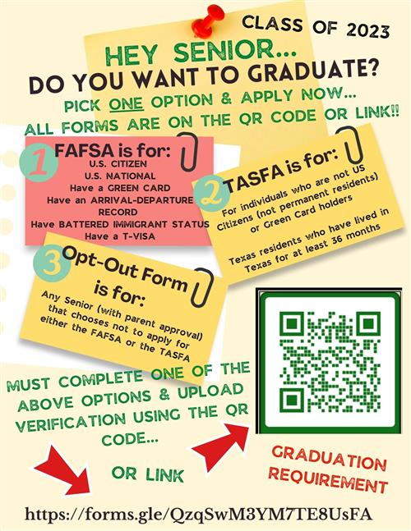
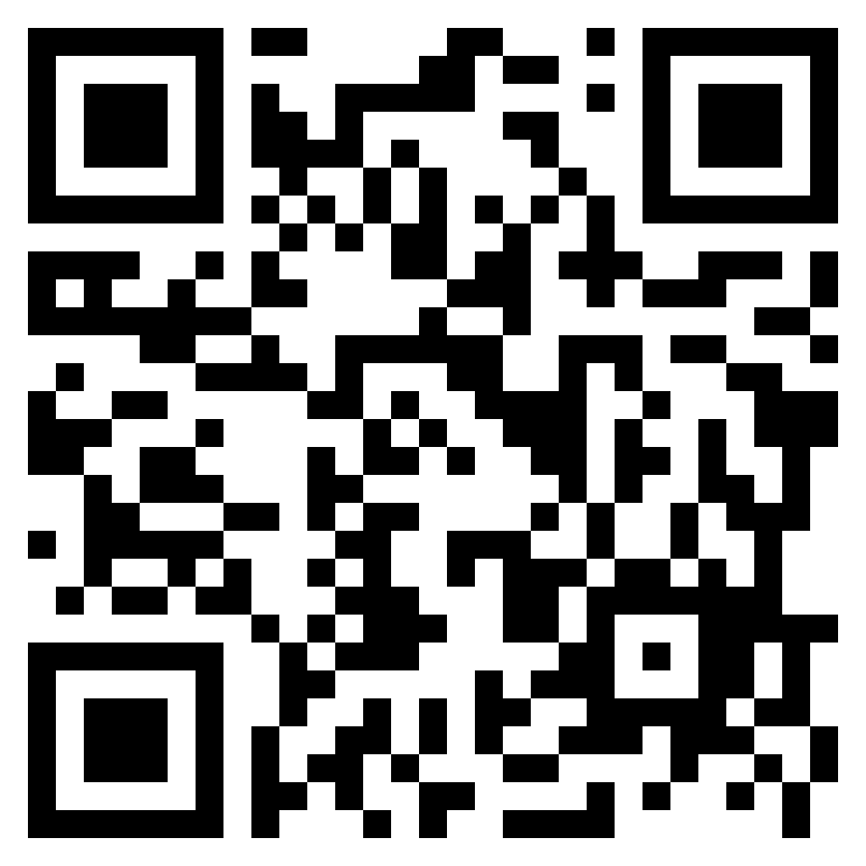
CLASS OF 2024
https://forms.gle/QR9dffqpd6R5D6Au9

